Slide 1

APARTMENT
MANAGEMENT SYSTEM

Slide 2

Team Members
RAKSHANNA KANTHAN
(RA2011003010145)
GUNNU JAIRAJ
(RA2011003010171)
ANUPAM PALAI
(RA2011003010206)

Slide 3
Abstract

Slide 4
The apartment management system has been designed to meet the various requirements of residents, one of which is the facilitation of car parking. To ensure efficient use of the car parking area, the system allows residents to book parking slots based on their availability. Additionally, the system enables residents to utilize the auditorium for conducting events, subject to the hall's availability. Furthermore, the apartment management system seeks to optimize the available parking facility within the premises By optimizing car parking utilization, addressing technical issues promptly, and facilitating online payments, the system enhances the living experience of residents and simplifies the work of the management team.

Slide 5
Objective

Slide 6
Objective
The Apartment Management System is a platform that has been designed to provide convenient solutions for managing various aspects related to apartment living. One of its primary functions is to facilitate the payment of bills, including maintenance bills and water bills. This feature enables apartment residents to pay their bills conveniently through the website, eliminating the need for manual processes or visits to the management office. Another useful feature of the Apartment Management System is the ability to make complaints.

Slide 7
Problem
statement

Slide 8
Problem statement
It is crucial to identify the problem and understand the requirements before starting the development process. With this website, there is no need to rely on manual processes and maintain records. The website offers a user-friendly interface that makes it easy for both apartment managers and residents to access and use the necessary features. Overall, the website aims to streamline the apartment management process, reduce manual labor, and enhance the living experience for residents.

Slide 9
General and Unique Services in the database application

Slide 10
General Services
Maintenance request submission and tracking
Bill payment for utilities and amenities
Resident contact information management
Rent payment processing and tracking
Complaint registration and resolution tracking
Announcement and notification management
Lease agreement and renewal management

Slide 11
Unique Services
Car parking slot reservation and management
Laundry and dry-cleaning service management
On-demand housekeeping and cleaning services
Guest room reservation and management
Catering and event planning services management
Concierge services for travel, entertainment, and dining reservations

Slide 12
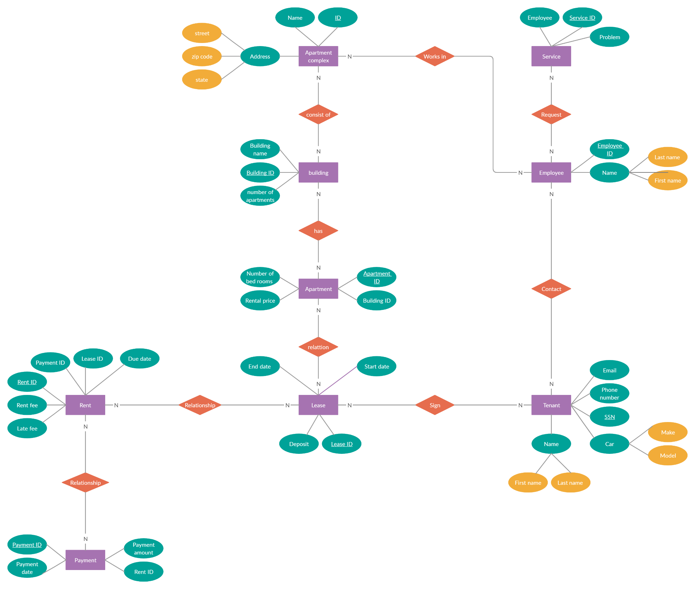
E-R diagram

Slide 13
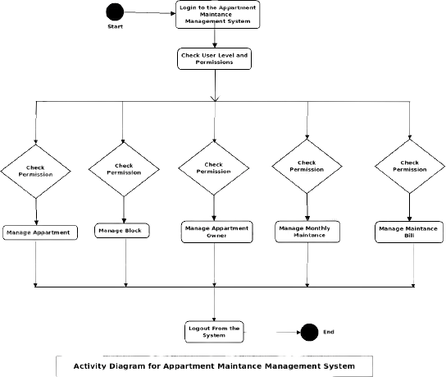
Activity diagram

Slide 14
Frontend (UI) design

Slide 15
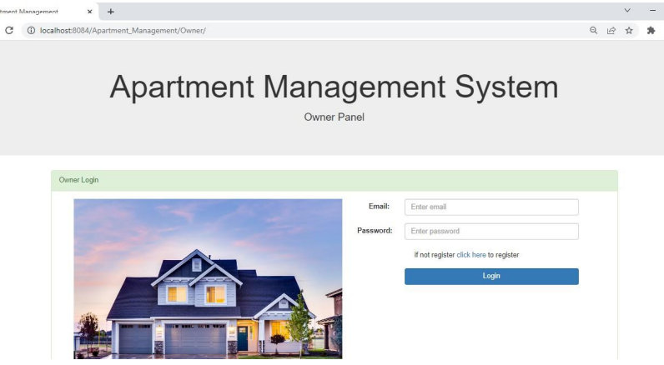
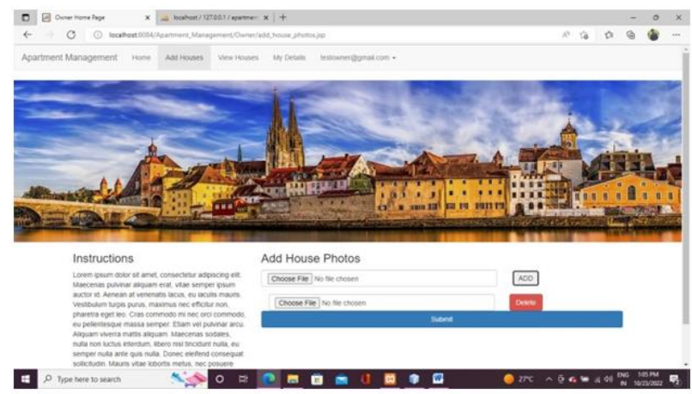
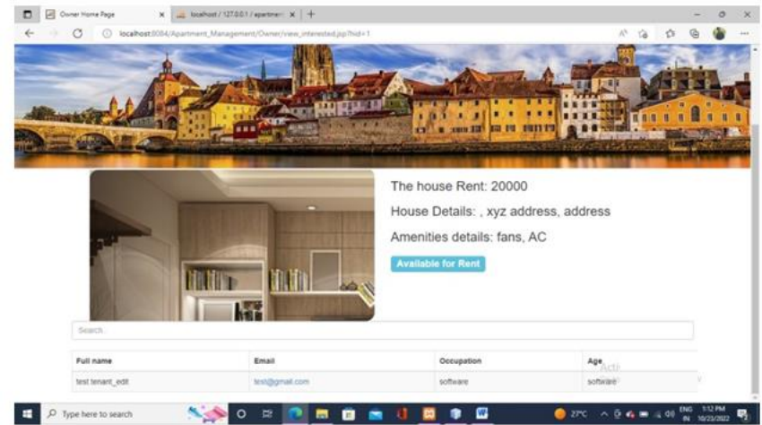
Frontend (UI) design
Fig.1 - Login page
Fig.2 - Details page
Fig.3 - Rentals page

Slide 16
Backend (DB) design

Slide 17
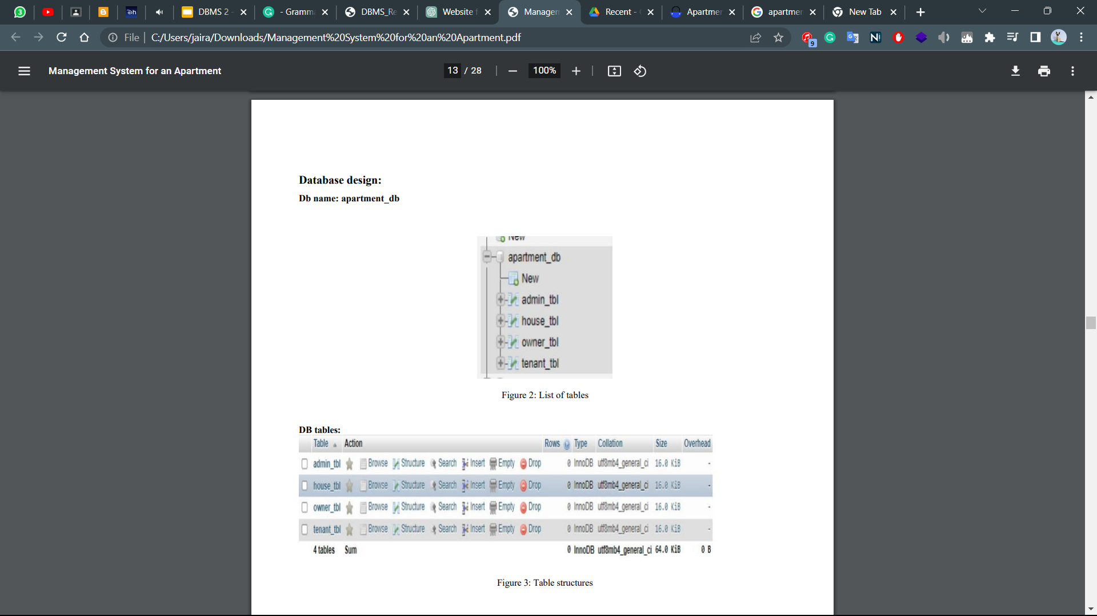
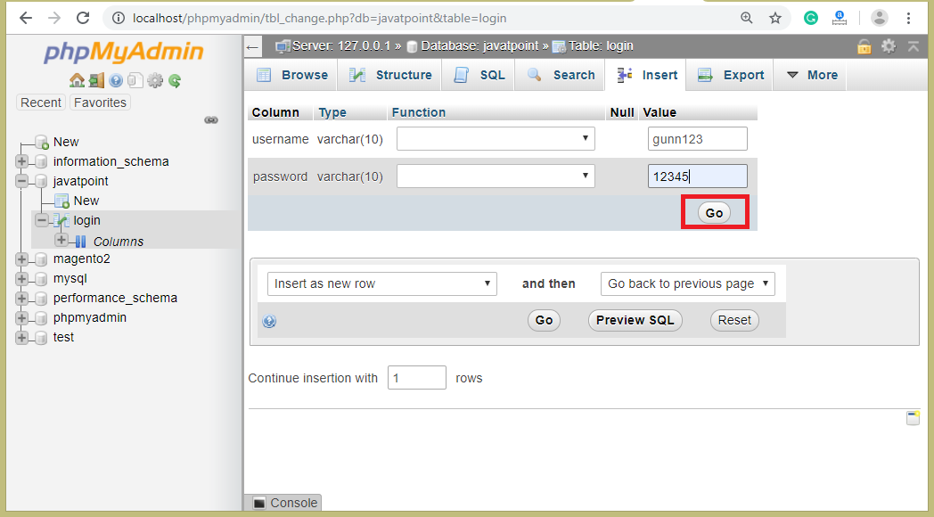
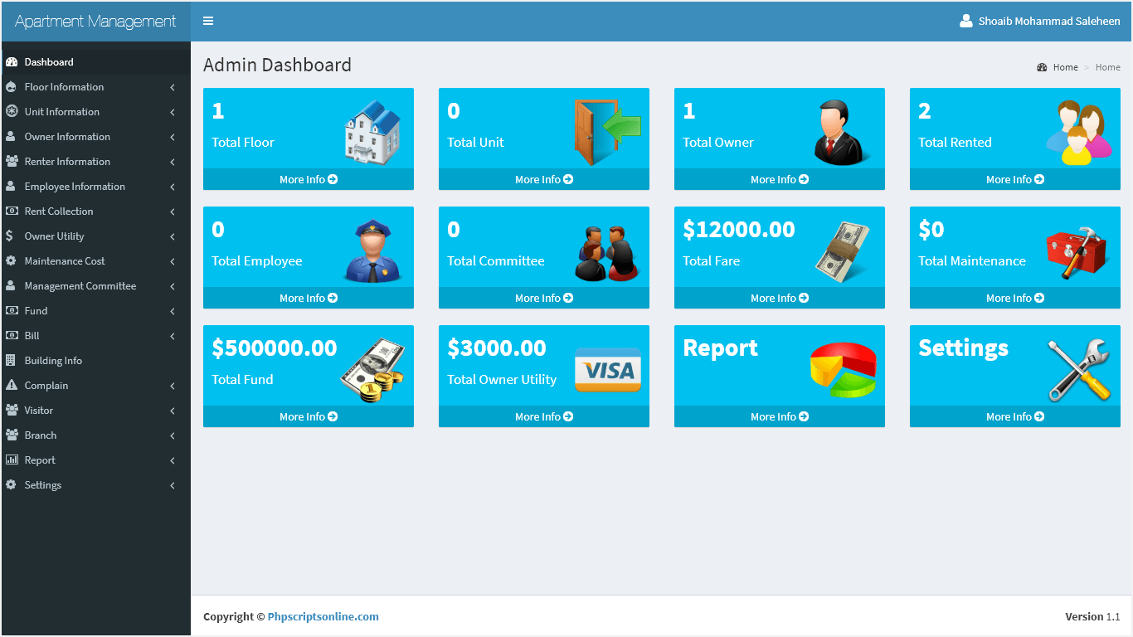
Backend (DB) design
Fig.4- List of php tables
Fig.5 - Database structure table
Fig.6 - PHP dashboard
Fig.7 - Database dashboard

Slide 18

Type of Connectivity used for database
The Apache HTTP Server Project is an effort to develop and maintain an open-source HTTP server for modern operating systems including UNIX and Windows. The goal of this project is to provide a secure, efficient and extensible server that provides HTTP services in sync with the current HTTP standards.
For Apartment management system, we would depend on various factors such as the features of the system, the number of tenants and owner, and the various things etc..

Slide 19
Modules and Functionalities

Slide 20
Modules & Functionalities
Owner module
Owner will register with the application, they can add the details of their house like address of the house, amenities present in the house, house rent, status of the house etc. owner will have some features like edit, add, delete, view, communicate with the tenant etc.
Tenant Module
Tenant should register with the application, he can view the different vacant apartments, houses in the selected locality. After communicating with the owners, they can become like a tenant in the house. Later he can communicate with the owner, he can keep track of all the payments, issues, and other related information related to the house etc.
Admin Module
Administrator is the privileged user when compared to the other user. He will be viewing all the operations of both tenant and owner. He can restrict the operations of both the tenant and the owner. He can even block the owner and tenant. He can able to communicate with both the tenant and owner. If we want any of the details of the owners and tenant, he can view all the information in the form of reports whenever needed and from wherever he wants.

Slide 21
References
https://propertymetrics.com/blog/how-to-analyze-supply-and-demand-for-apartment-buildings/
https://vertabelo.com/blog/a-data-model-for-listing-apartments-and-other-rental-units/
https://adarshjournals.in/index.php/ajmr/article/viewFile/122286/84098
https://alndata.com/update-your-property/

Slide 22

Thank you!
Have a great day!

